Slide 1
Dinghy
Mattias, Niklas, David, Fredrik, Jesper, Alexander, Björn

Slide 2

Team Building
Taco
Singstar
Shots
Super smash
Mario kart (alpha car confirmed)

Slide 3
Delays (not because of team building or hangovers)
Report
Waiting for order

Slide 4
Requirements
Set by Jan
Direction, bearing
Speed over ground
Inclination
Angular Velocities
Position(within 1 inch)
Differential pressure over center board
Dual Wireless Communication
Feedback to skipper
Things we made up
Vindsensor
Log/statistics
Feedback to skipper (extended)

Slide 5
Groups
Position
Hardware
Software

Slide 6
FMEA
FMEA-link

Slide 7
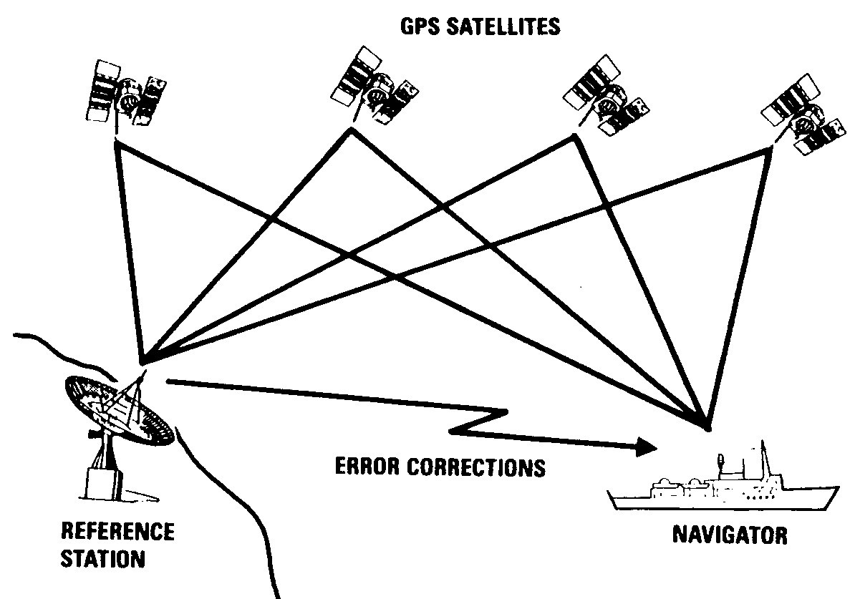
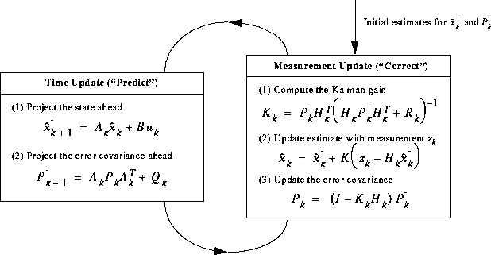
Positioning
Sensor fusion
DGPS+IMU
Sjöfartsverket
Free to use
Reception
RTCM SC-104
Extended Kalman Filter

Slide 8
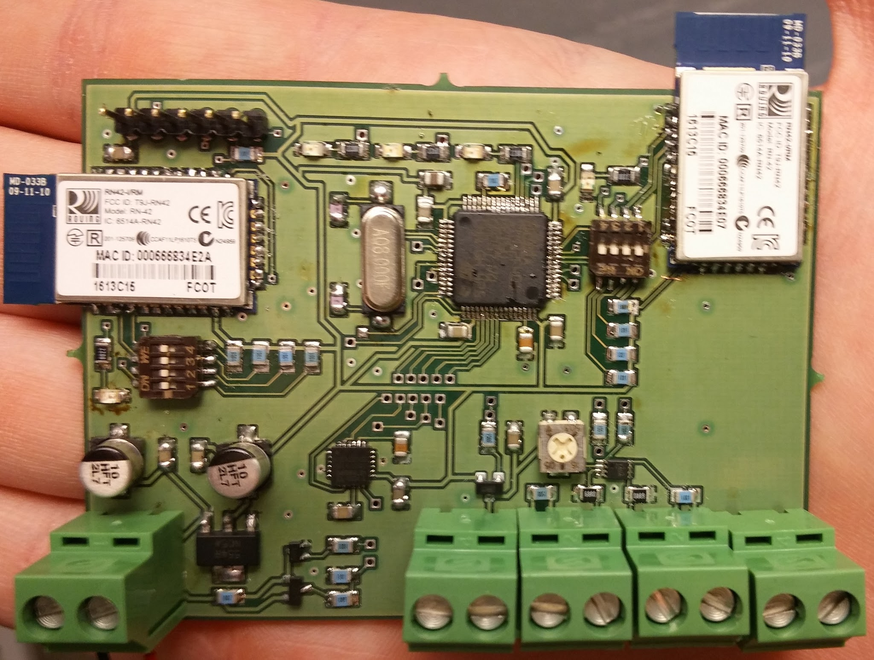
Main board

Slide 9
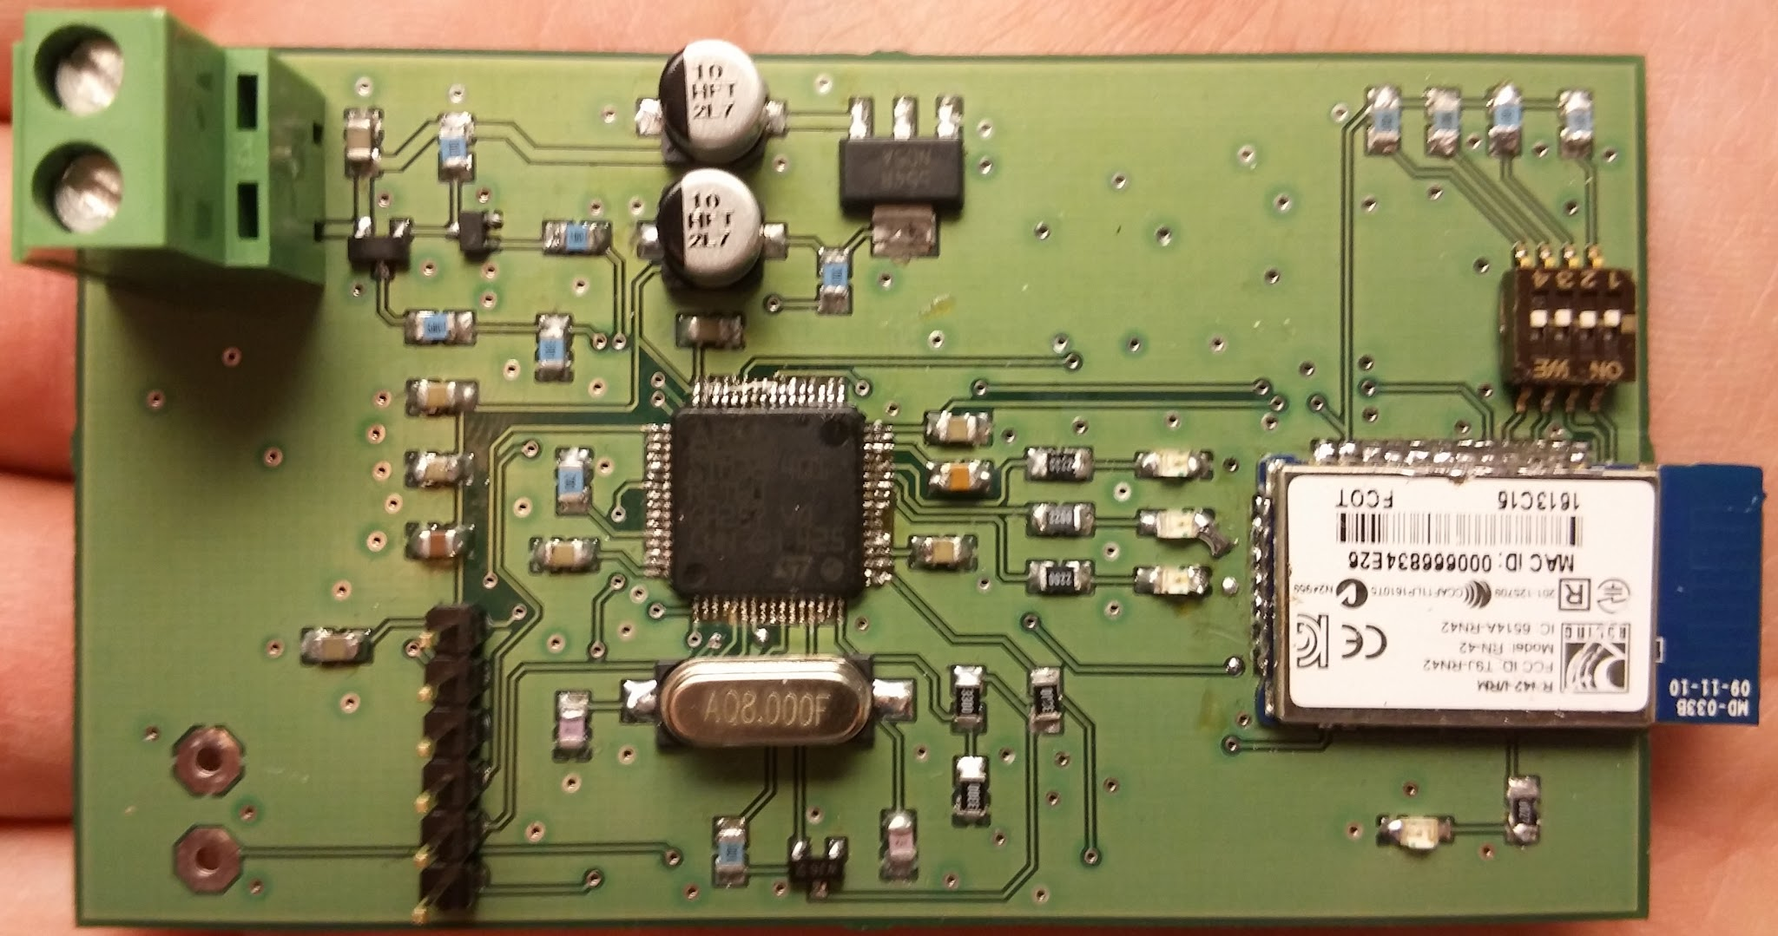
Rudder

Slide 10
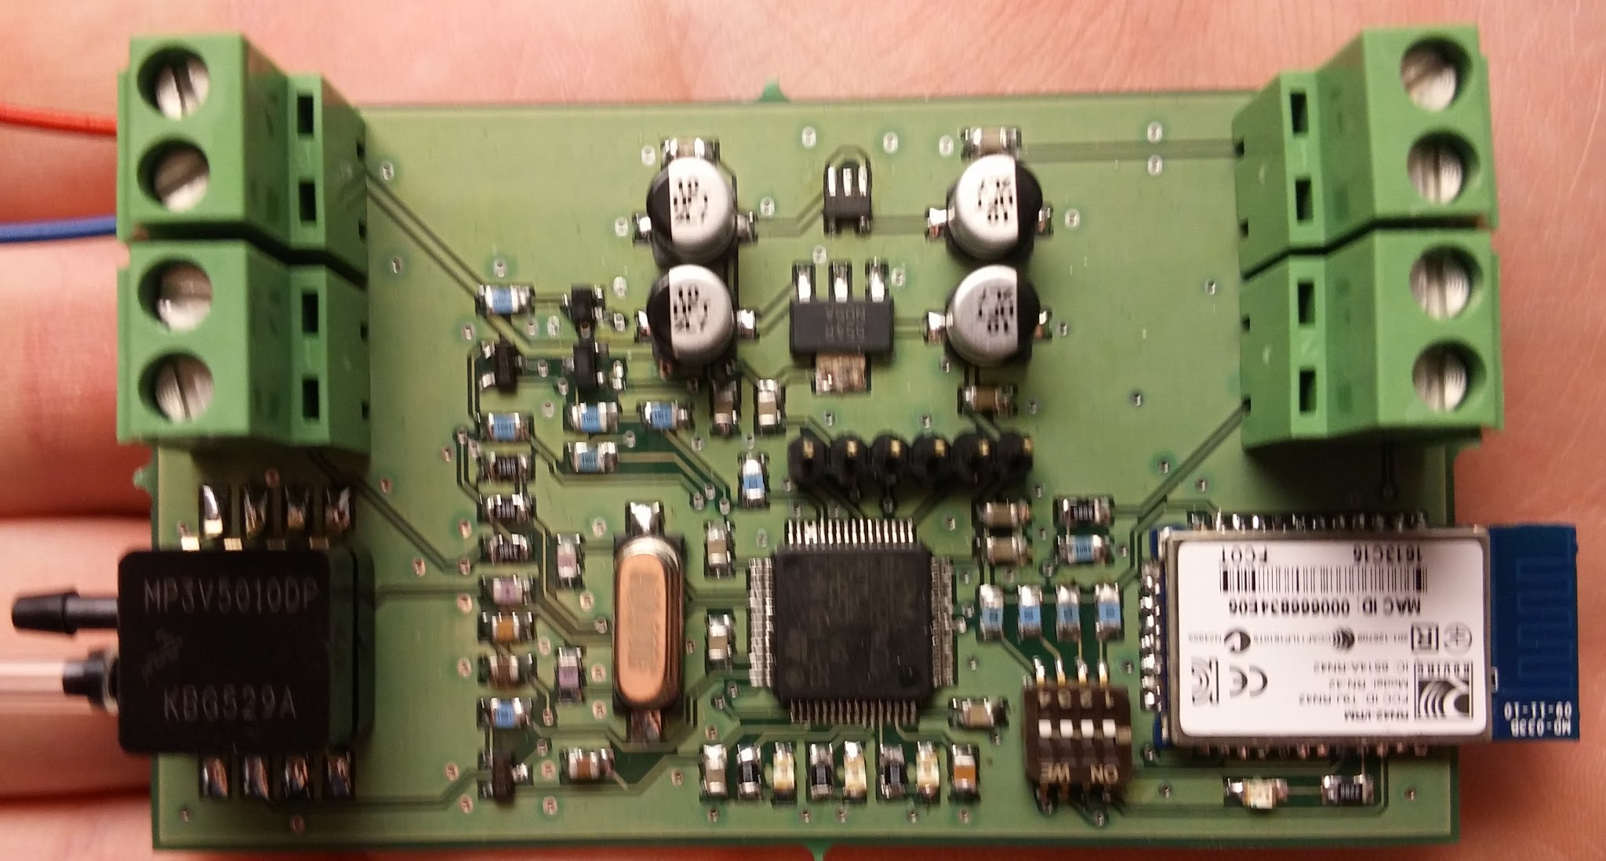
Center

Slide 11
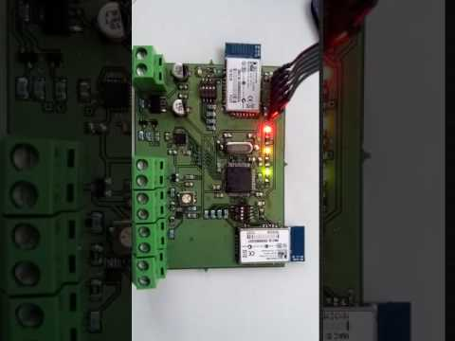

Slide 12
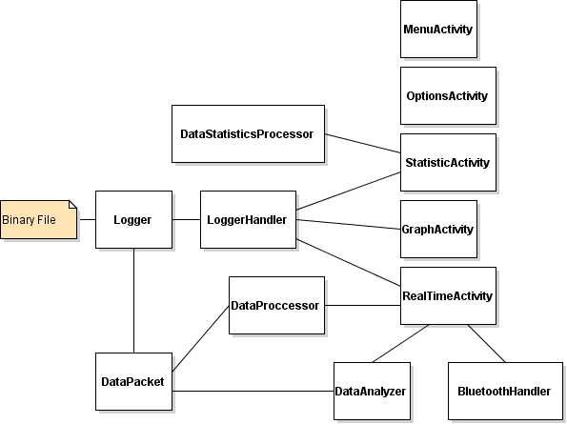
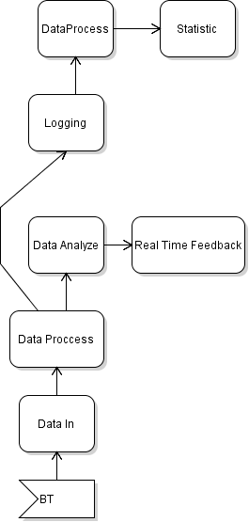
Application

Slide 13
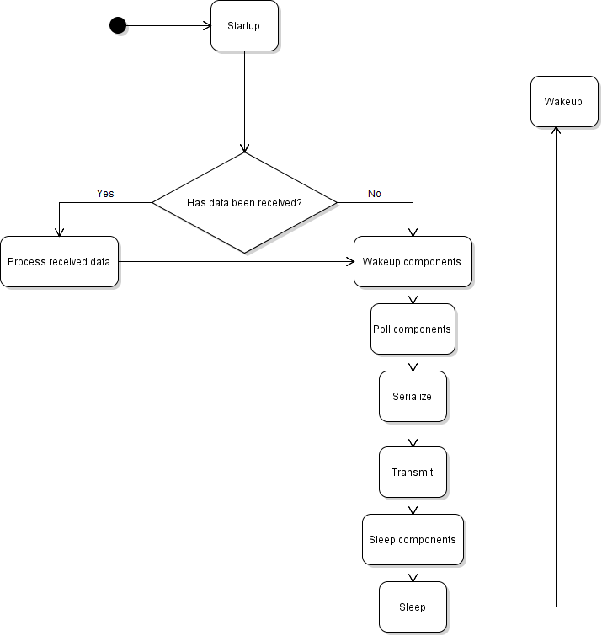
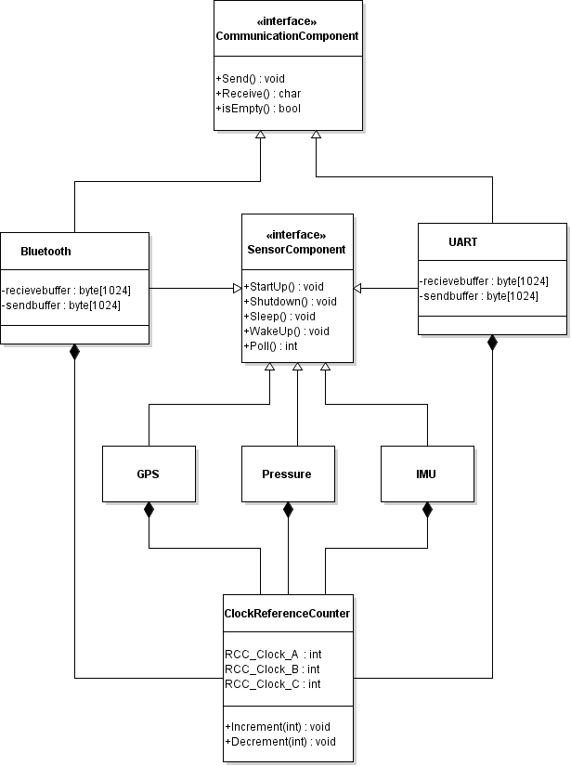
Software - embedded

Slide 14
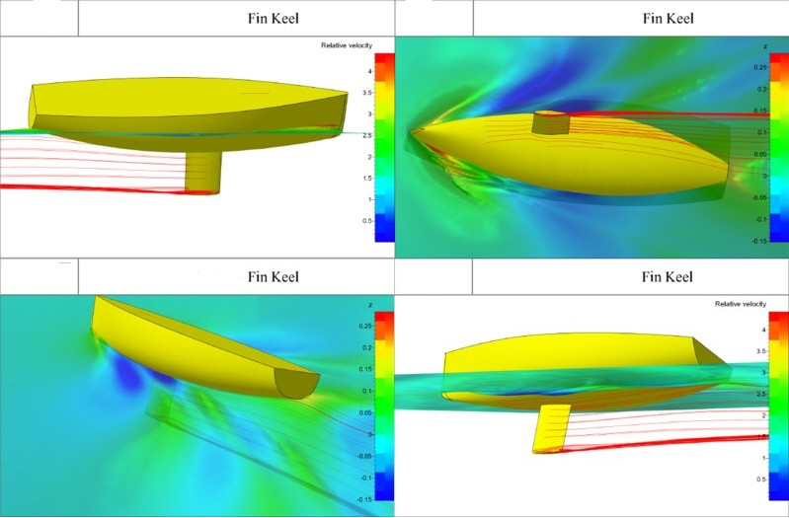
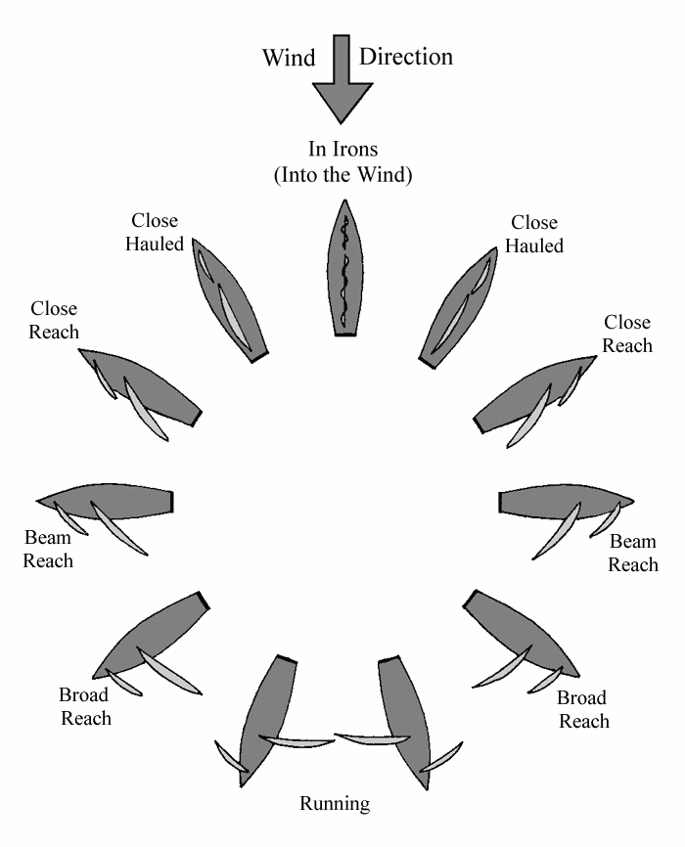
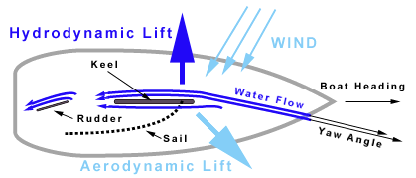
Research
Logic of pressure on Rudder and Centerboard is under development
Goal: Logic for all points of wind
NMEA
Libs in C
Hard code which sentences to send to save energy
Alterations to next HW iteration?

